Slide 1
The Effectiveness of Honeycomb to Reduce Boundary Layer Thickness
Company 2
Khaled Almutiri
Abdullah Sifat
Priessia Megarukmi Niswantari

Slide 2
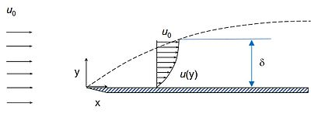
Introduction: B.L. & its Profile

Slide 3
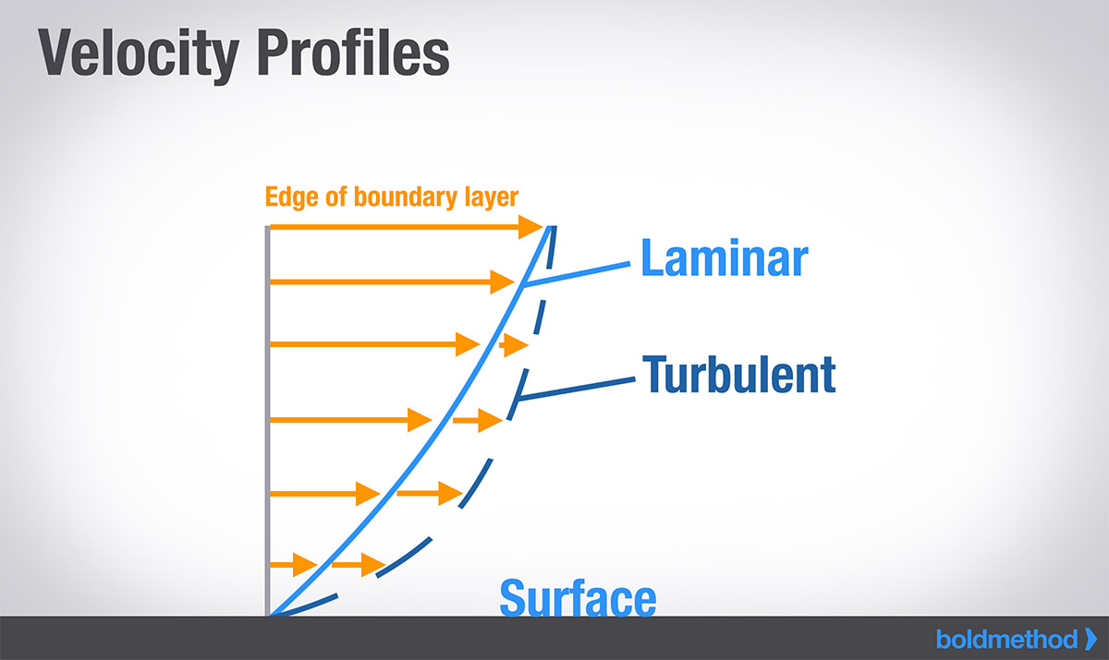
Laminar & Turbulent

Slide 4
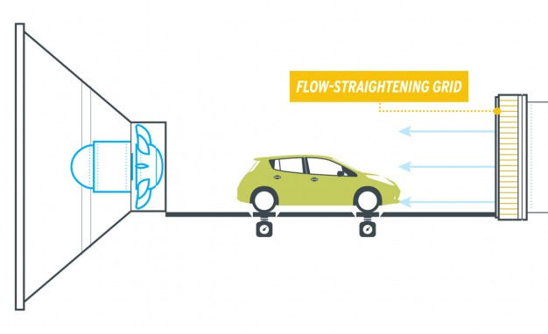
Ground Vehicle in Wind Tunnel

Slide 5
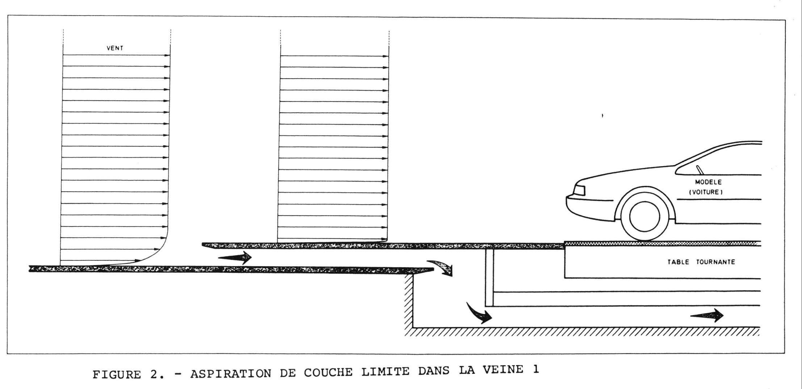
One way to Reduce B.L. in Wind Tunnel

Slide 6
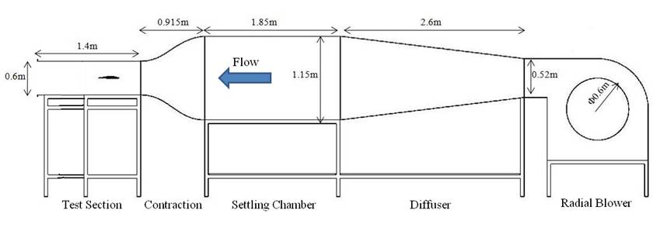
Our Way (Honeycomb installed)
Honeycomb

Slide 7
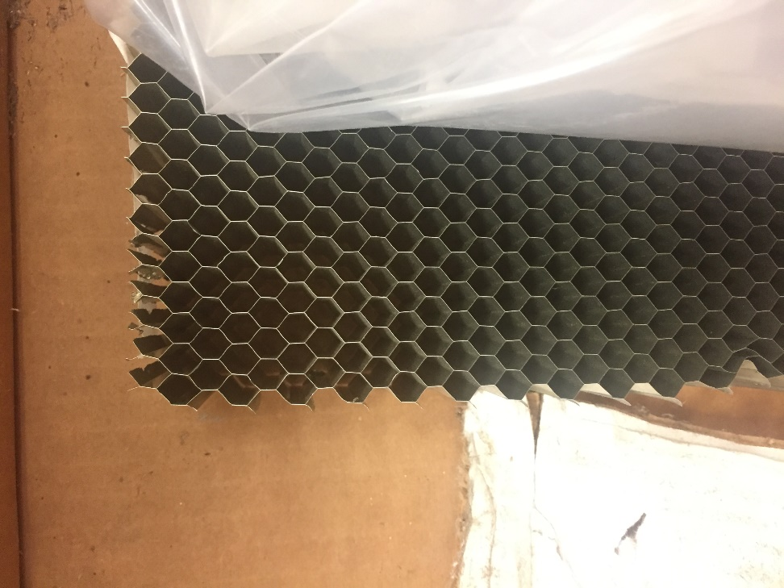
Material
Aluminum Honeycomb:
Dimension: 13.875in x 5.875in
Thickness: 0.75in, 1.5in, 2.25in

Slide 8
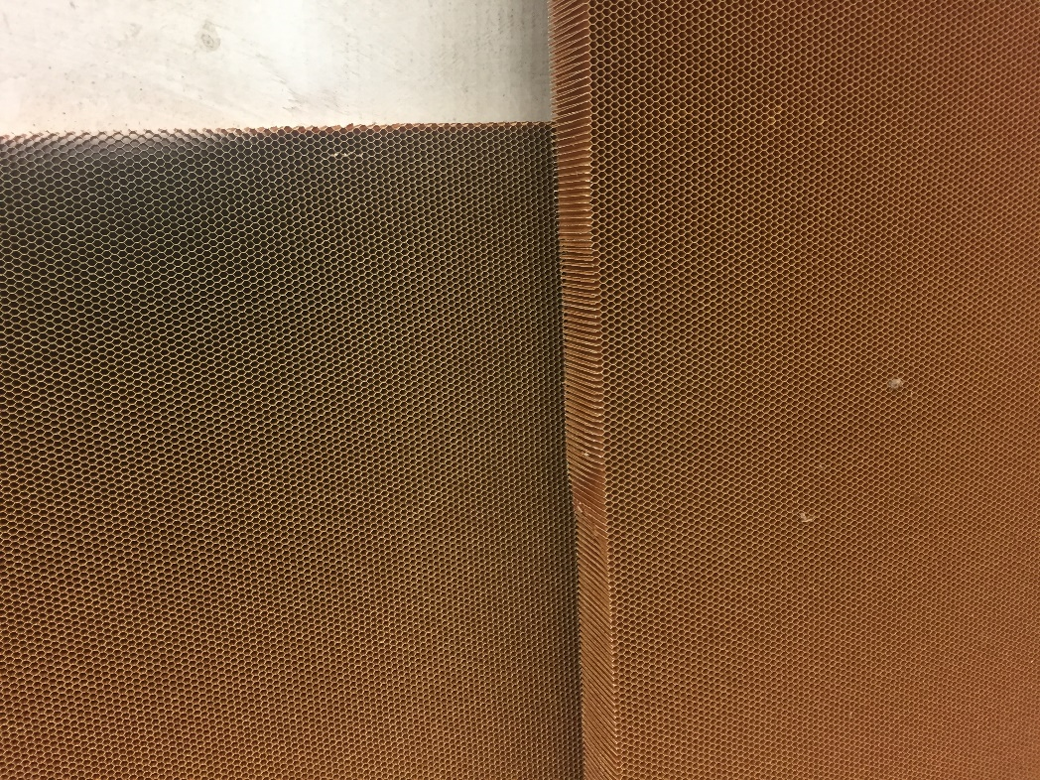
Material
Nomex Honeycomb:
Dimension: 13.875in x 5.875in
Thickness: 0.75in, 1.625in, 2.375in

Slide 9
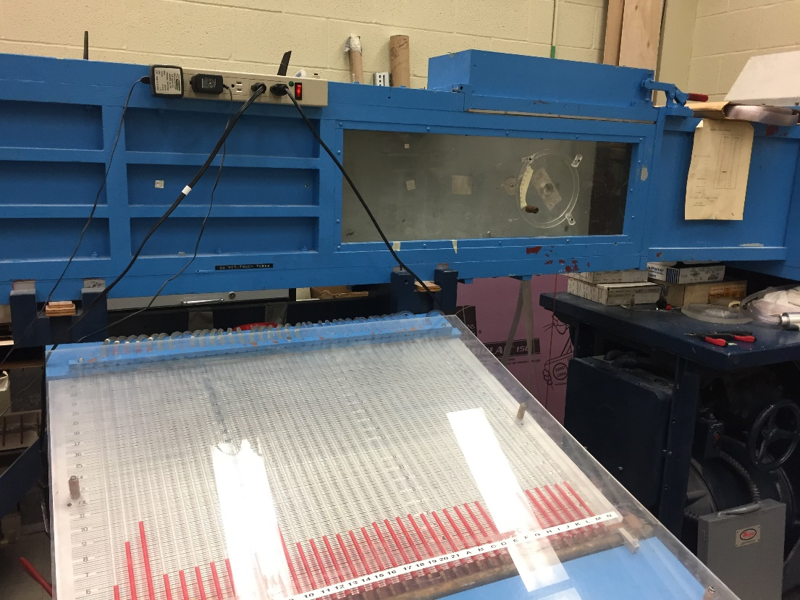
Boundary Layer Tunnel

Slide 10
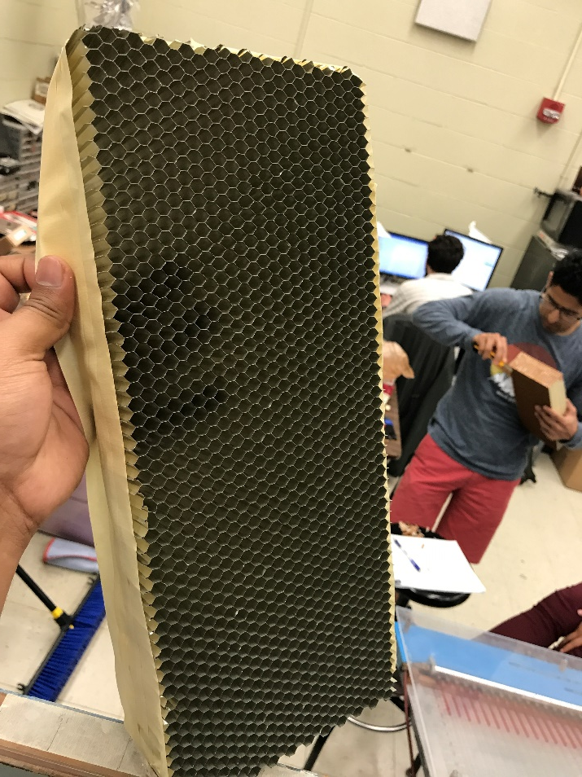
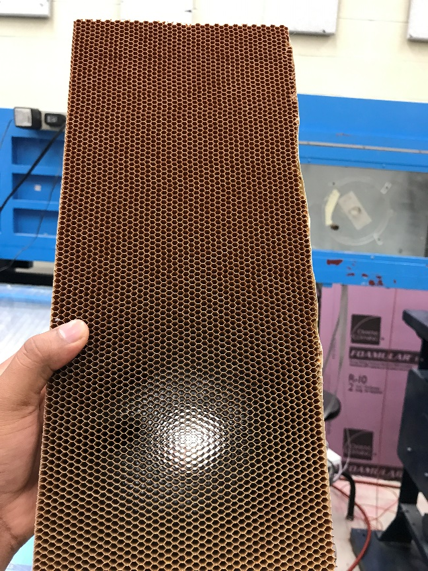
Experiment: Procedure
Paper tape on the sides of honeycombs.
Distance: 5 inches.
Freestream velocity: 58 ft/s (approx.)

Slide 11
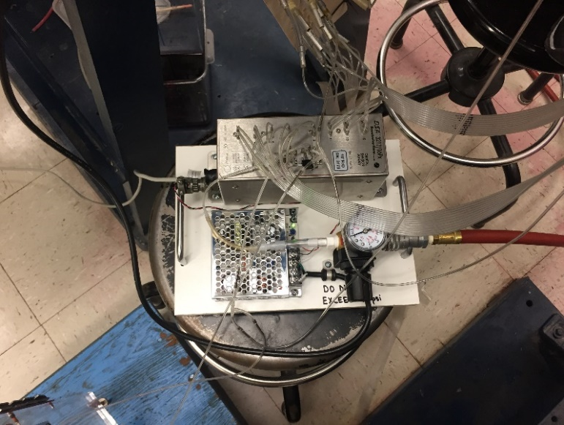
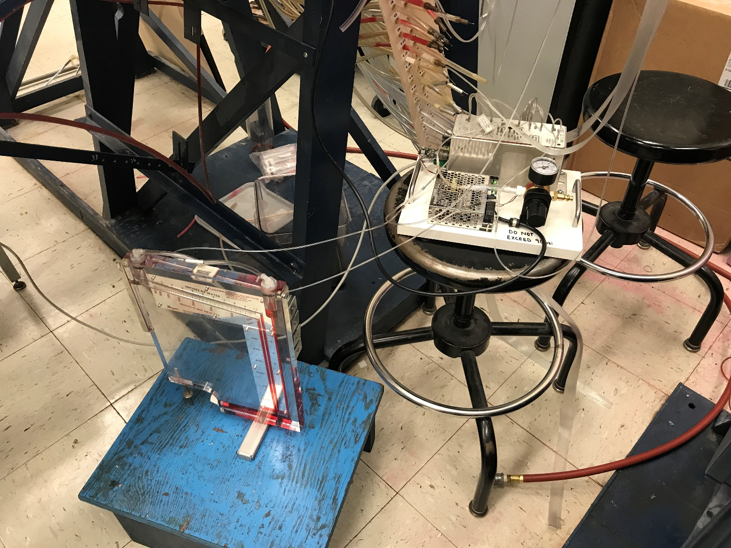
Experiment: What is Scanivalve?
Scanivalve DSA 3217
Static pressure on the wall used as the pressure reference.

Slide 12
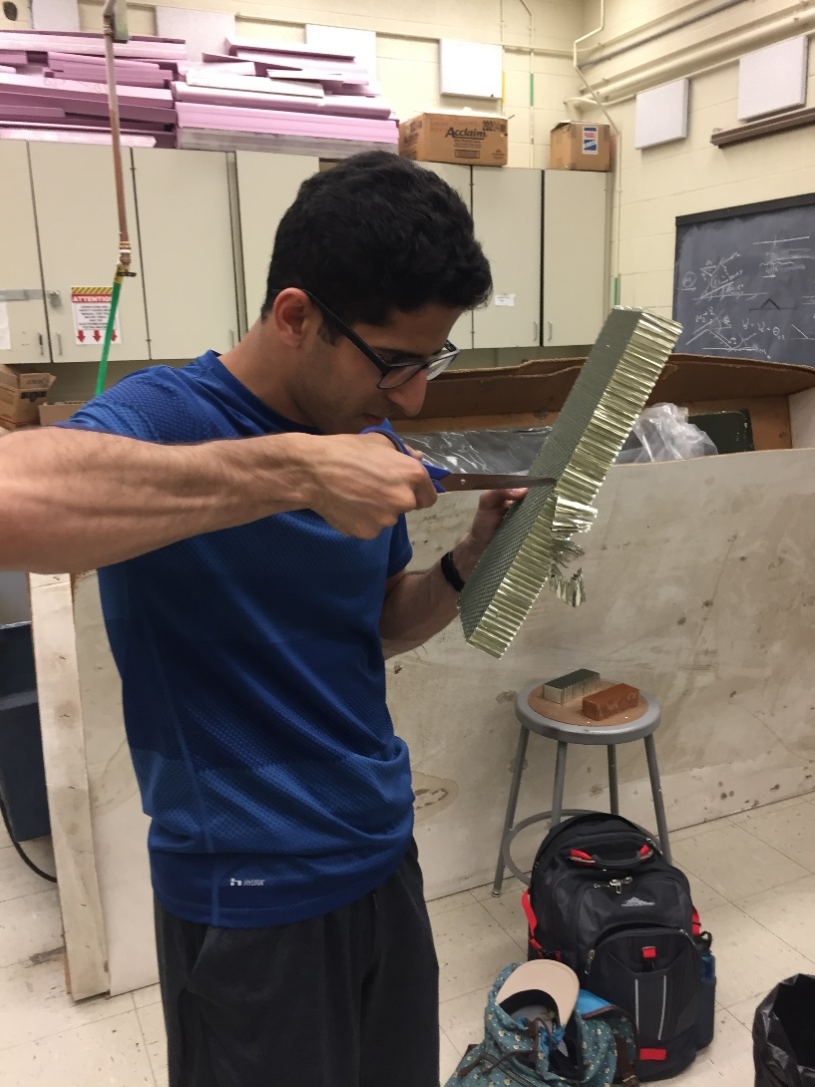
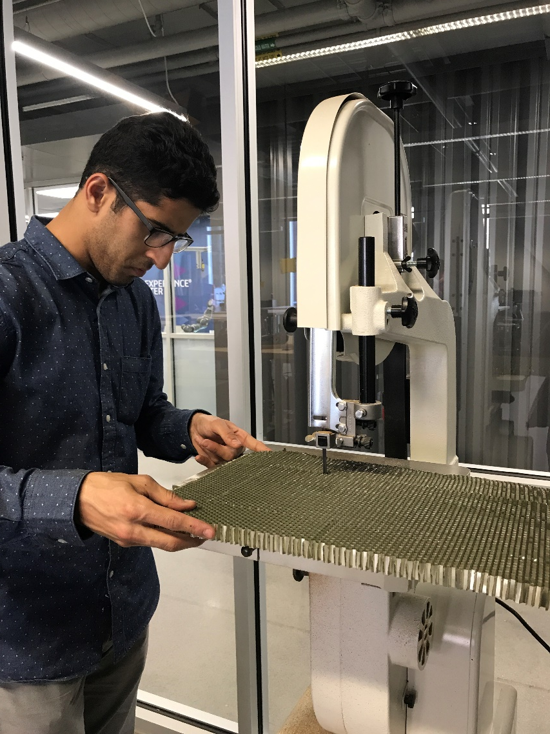
Experiment

Slide 13
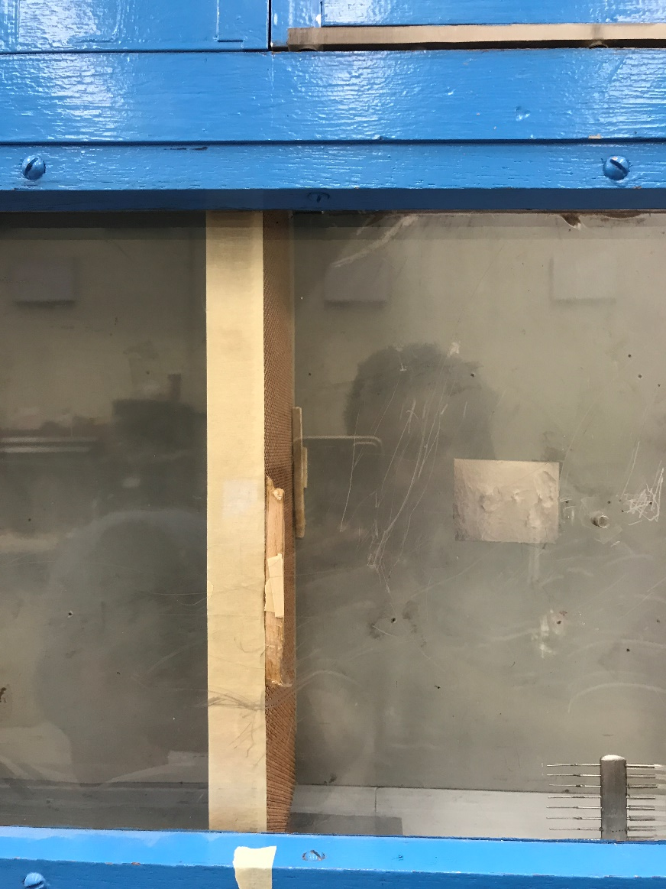
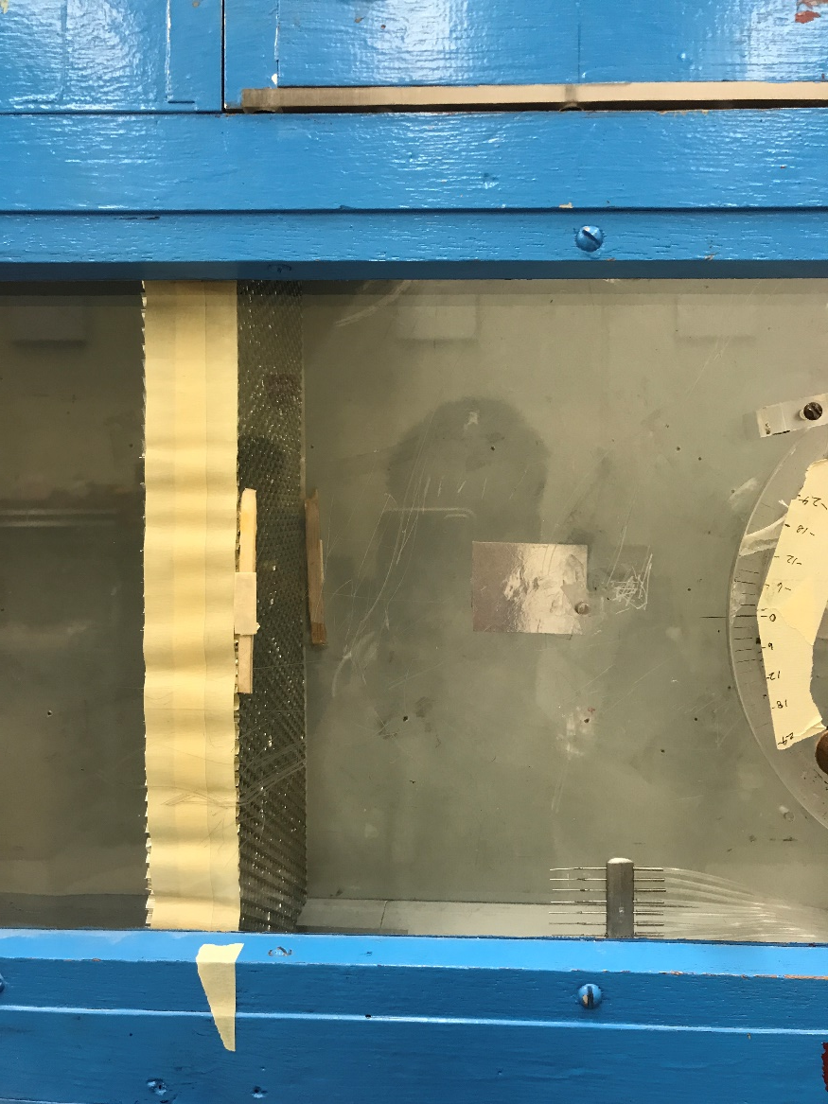
Experiment

Slide 14
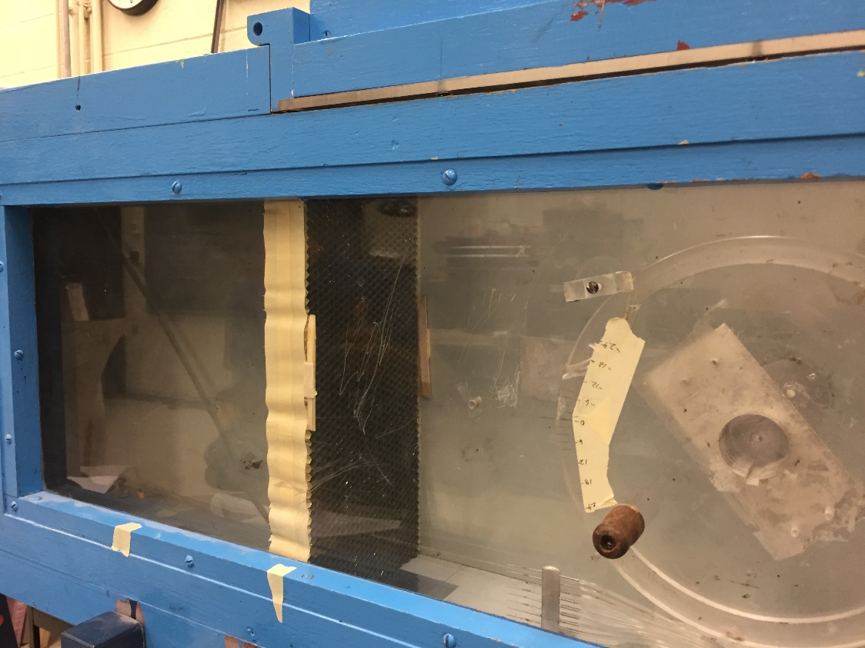
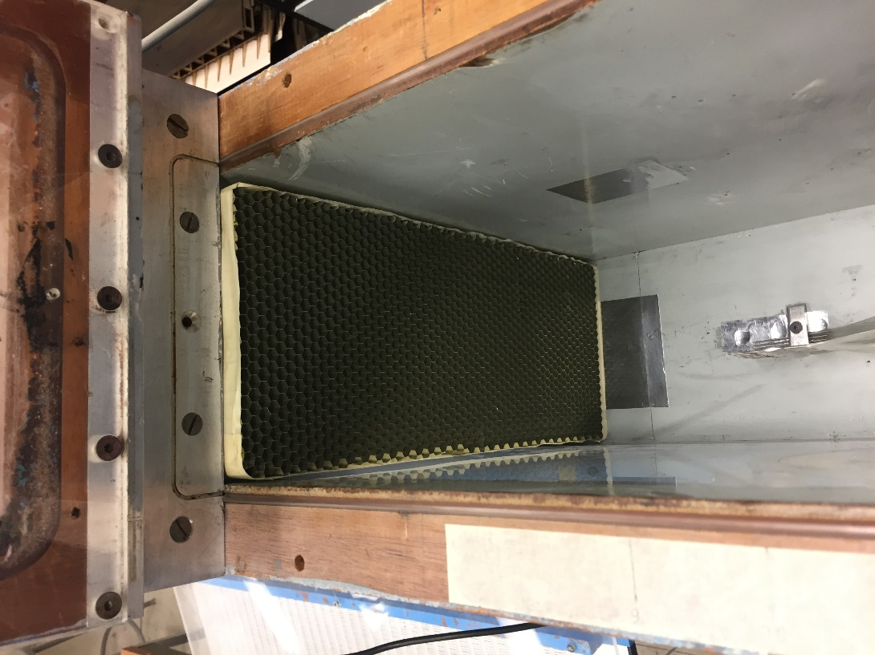
Experiment

Slide 15
Results

Slide 16
Results

Slide 17
Results: Explanation
Boundary layer Thickness Reduction:
Nomex Combine (2.375 in) – 63 %
Nomex Thick (1.625 in) – 38 %
Nomex Thin (0.75 in) – 20 %
Aluminum Combined (2.2 in) – 25 %
Aluminum Thick (1.5 in) – 20 %
Aluminum Thin (0.75 in) – 10 %

Slide 18
Results: Explanation
Free Stream Dynamic Pressure Loss:
Nomex Combine (2.375 in) – 35 %
Nomex Thick (1.625 in) – 13 %
Nomex Thin (0.75 in) – 7 %
Aluminum Combined (2.2 in) – No Loss
Aluminum Thick (1.5 in) – No Loss
Aluminum Thin - No Loss

Slide 19
Future Works
Bigger scale experiment.
Range distance need to be used.
Perfect shape.

Slide 20
Questions??

